Slide 1
Carrier Trading Center
Supervisor: Mr. Nguyễn Văn Sang
Lê Văn Dương
Trịnh Đình Quyết
Vũ Văn Quyết
Lê Gia Hoàng
Đặng Lê Tuấn

Slide 2
Presentation Outline
Project Overview
Project Management
Software Specification
Software Design
Testing
Project Result
Demo

Slide 3
Project Overview
Current Situation
Why Carrier Trading Center?
Current situation
The ideas
The objectives

Slide 4
Project Overview
Current situation
Current situation:
Nowadays, in our country, which is a developing country, transportation becomes more and more popular because of the rising of economy.
But according to survey, there are 83% trucks and containers with empty cargo on return. Which mean they are only deliveries one-way.
A LOT OF EMPTY CONTAINER TO FILL WITH GOODS AND CARGOES TO DISTRIBUTE

Slide 5
Project Overview
Current situation
Transporter has to find customer to delivery goods on the way return
Meeting to take goods and confirmation contract money, time and place of destination
There lots of outcomes will happens:
Trading successfully
Scammer loses goods or money from delivery
…
CARRIER AND GOODS OWNER NEEDS AN INTERMEDIATE BETWEEN THEM TO MAKE CONTRACTS

Slide 6
Project Overview
Technology Trends

Slide 7
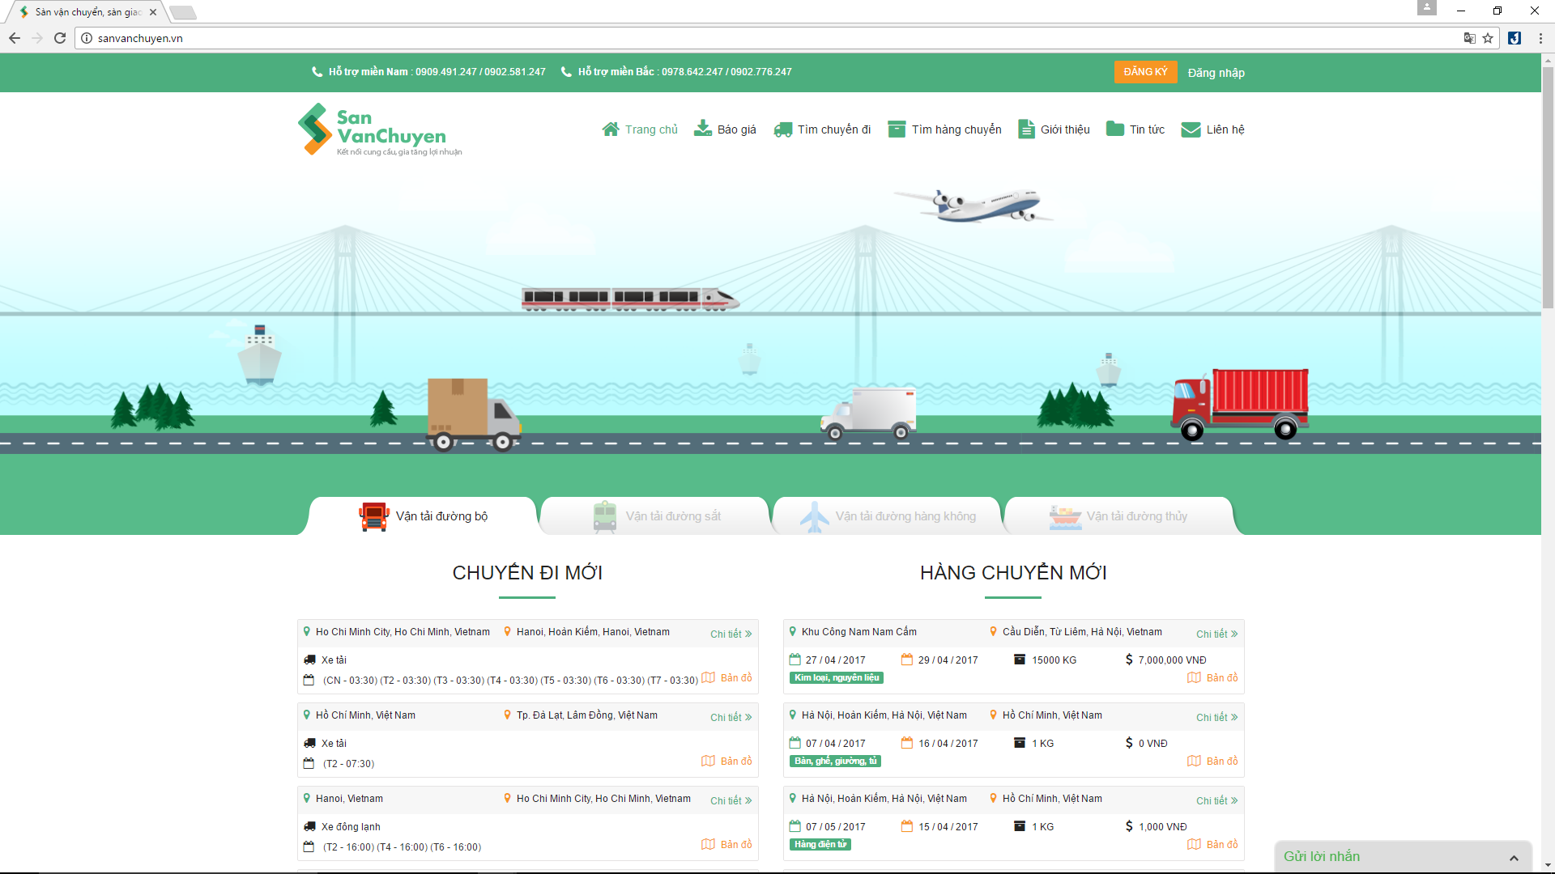
Project Overview
Current Application Limitation
Advantage:
Friendly with user
Easy-to-use
Lots of ways to transportation
Disadvantage:
Scammer and phishing
Missing lots of information about users
sanvanchuyen.vn

Slide 8
Project Overview
Current Application Limitation

Slide 9
Project Overview
The Ideas
Carrier Trading Center:
Friendly with user
Easy-to-use
Detail information of user – more trustable when transaction
Pay in cash or by banking system

Slide 10
Project Overview
Objectives
Fulfill requirements from FPT University
Develop a product that expressed the above ideas
Study new technologies: Hibernate Framework, JSF etc.
Apply project development and software process
Practical ways of working in groups
Have skills in communication, time management, risk management etc.

Slide 11
Project Overview
Management

Slide 12
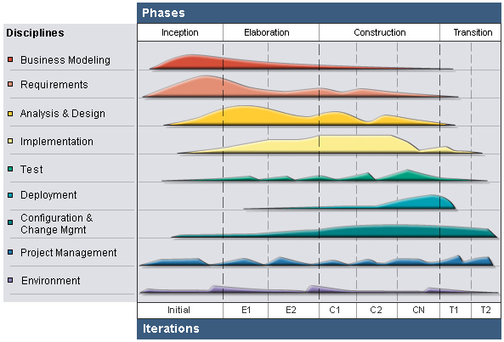
RUP Model
Project Management
Management
Project Model

Slide 13
Develop iteratively
Project Management
Management
Project Model
Supports an iterative approach to development that addresses the highest risk items at every stage in the lifecycle, significantly reducing a project’s risk.
Manage requirements
Managing requirements during the whole development process ensures project team develops the right system with right requirements
Verify software quality
Very important for inexperienced team in controlling issues like us.
Testing process is implemented in all the cycles of application development time
Reduce risks

Slide 14
Project Management
Management
Inception
Study business case and feasibility study of project
Complete draft ERD of system
Complete draft screen prototypes
Complete draft requirements
Determine project scopes
Complete project management plan

Slide 15
Project Management
Management
Elaboration
Complete user requirement specification
Complete software requirement specification
Complete ERD, final prototypes
Complete database model
Complete system architecture design

Slide 16
Project Management
Management
Construction & Transition
Construction:
Complete coding and unit test
Complete functional and regression test
Complete user manual
Transition:
Deploy website
Deliver source code
Complete all reports and documents

Slide 17
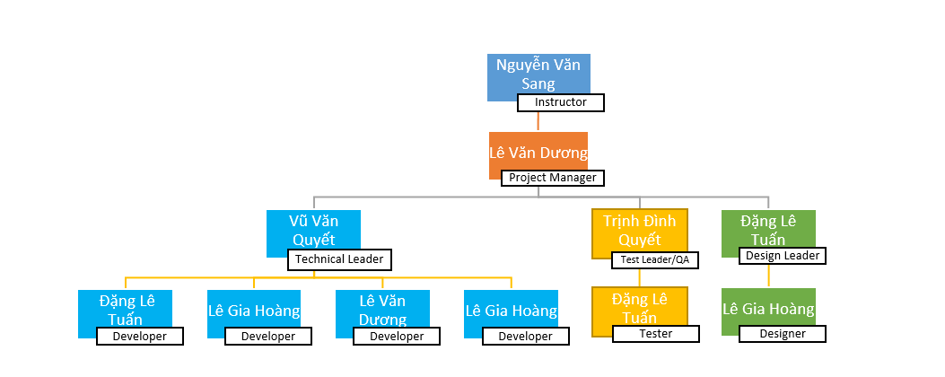
Organization structure
Project Management
Management
Organization Structure

Slide 18
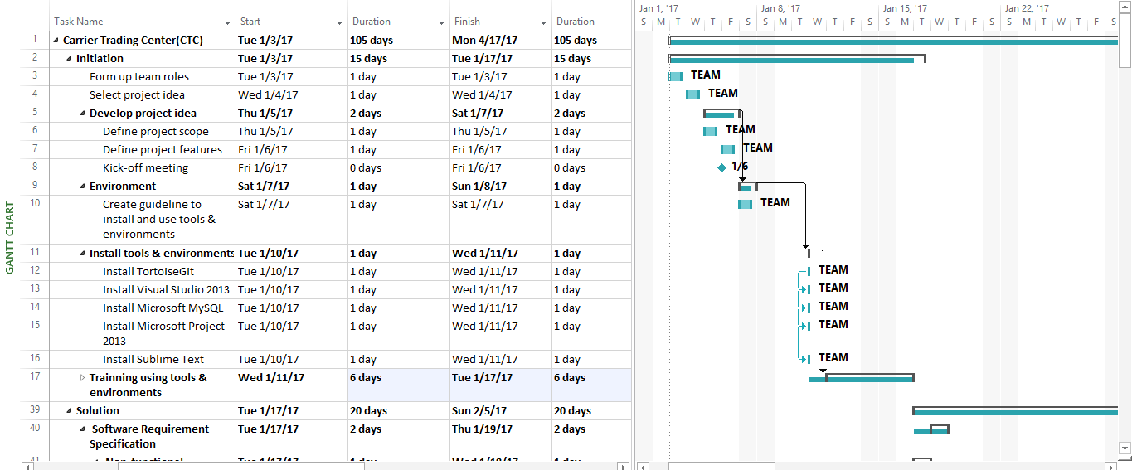
Project Management
Management
Master Schedule

Slide 19
Project Management
Management
Objectives
Metrics | Unit | Committed | Actual | Deviation
Start Date | dd-mm-yyyy | 03-01-2017 | 03/01/2017 | 0 days
End Date | dd-mm-yyyy | 17-04-2017 | 17-04-2017 | 0 days
Duration | Elapsed days | 105 days | 105 days | 0 days

Slide 20
Project Management
Management
Deliverable
No | Stage | Deliverable/ Milestone | Delivery Date | Delivery Location
1 | Initiation | Deliver Report No.1 | 09/01/2017 | Supervisor
3 | Initiation | Deliver Report No.2 | 16/01/2017 | Supervisor
4 | Solution | Software Requirement Specification | 10/02/2017 | Supervisor
5 | Solution | System Architectural Design | 24/02/2017 | Supervisor
6 | Construction | Complete Coding | 18/03/2017 | Supervisor
7 | Construction | Deliver Report No.5 | 24/03/2017 | Supervisor
8 | Construction | Deliver Report No.6 | 13-12-2013 | Supervisor
9 | Termination | The last Document and CD source code | 17/04/2017 | FU
10 | Termination | Project completed | 26/04/2017 | FU

Slide 21
Project Management
Management
Tools & Environment

Slide 22
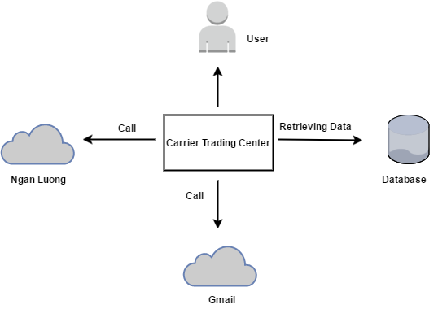
Software Specification
System Overview

Slide 23
Software Specification
Functional Requirement

Slide 24
Software Specification
Non-functional Requirement

Slide 25
Software Design
Architecture Presentation

Slide 26
Software Design
Package Design

Slide 27
Software Design
Entity Relationship

Slide 28
Testing
Test Model
Customer requirement
validate
Acceptance test
Product specifications
verify/validate
System test
High-level design
verify
Integration test
other V&V activities
Low-level design
verify
Component test
Coding & unit test

Slide 29
Testing
Test Model
Why choose V-model?
Simple and easy-to-use
Testing activities like planning, test designing happens well before coding
Proactive defect tracking
Avoids the download flow of the defects
Works well for smart projects where requirements are easily understood

Slide 30
Testing
Test Process

Slide 31
Testing
Test Environment & Resources
Environment:
Name | Purpose | Detail
Resources:
Member | Position | Responsibilities

Slide 32
Testing
Test Result
No | Module | Test Case |  |  |  | Checklist |  |  | Total
 |  | Yes | No | Untested | N/A | Yes | No | N/A
1 | Guest
2 | Carrier
3 | Goods Owner
4 | Admin
5 | Total
Test coverage:
Test case pass:

Slide 33
Project Result
Compilation Result
Main objectives | Create a web application that connect Goods Owner and Carrier with to minimize transportation costs.
Purpose | Create a new system in circumstance there is no similar system exists.
Items | Plan | Actual
Releases date | 05/05/2017 | 05/05/2017
Releases version | 1.0 | 1.0
Days | 105 | 105
Test cases + checklists |  | ????
Defects |  | ????
Document pages | ???? | Approximately ????
Lines of code |  | Approximately ????

Slide 34
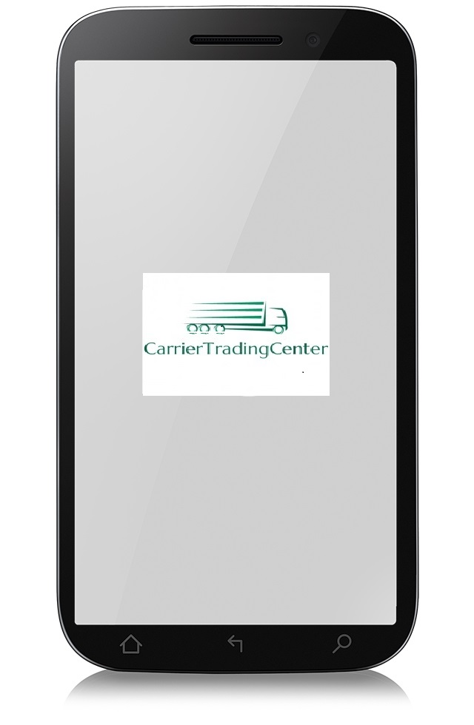

Project Result
Limitation & Expectation
Doesn’t have mobile version to make it easier to access from anywhere

Slide 35


Project Result
Limitation & Expectation
Guest cannot have a live chat with supporter of Carrier Trading center

Slide 36


Project Result
Limitation & Expectation
Language used is only Vietnamese

Slide 37


Project Result
Lesson Learned
Asking other for helping when stressed, deadline is coming closer.
Asking

Slide 38
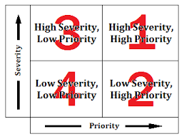

Project Result
Lesson Learned
Prioritize work, focus on something more important

Slide 39
Questions & answers

Slide 40
demo

